Slide 1
The Software Industry
Prof. Dr. Dirk Riehle
Friedrich-Alexander University Erlangen-Nürnberg
PROD B03
Licensed under CC BY 4.0 International
Notes:
It is Friedrich-Alexander University Erlangen-Nürnberg – FAU, in short.
Corporate identity wants us to say “Friedrich-Alexander University”.

Slide 2
Software as a Product (Recap)
Product
  A man-made artifact sold to customers in a market
Software
  Has an open-ended life-cycle: Is born, may live forever
  Typically requires upfront capital investment (development)
  Is cheap and easy to reproduce perfectly
Software as a product
  A product sold to either enterprise or retail customers
  What is sold is typically a usage right plus services

Slide 3
The Software Industry
The software industry
  Is the set of business that provides
    Software products and
    Software services such as
      Operating services
      Consulting services
        Development services
        Implementation services
  to other industries as well as itself
The software industry
  Is highly concentrated
  Is highly internationalized
  Has strong network effects
  Has a high speed of innovation
  Is rapidly expanding into new domains

Slide 4
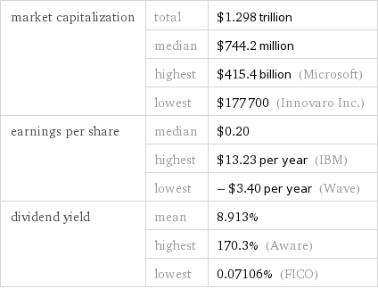
The Software Industry in 2016 [1]
[1] https://www.wolframalpha.com/input/?i=how+big+is+the+software+industry

Slide 5
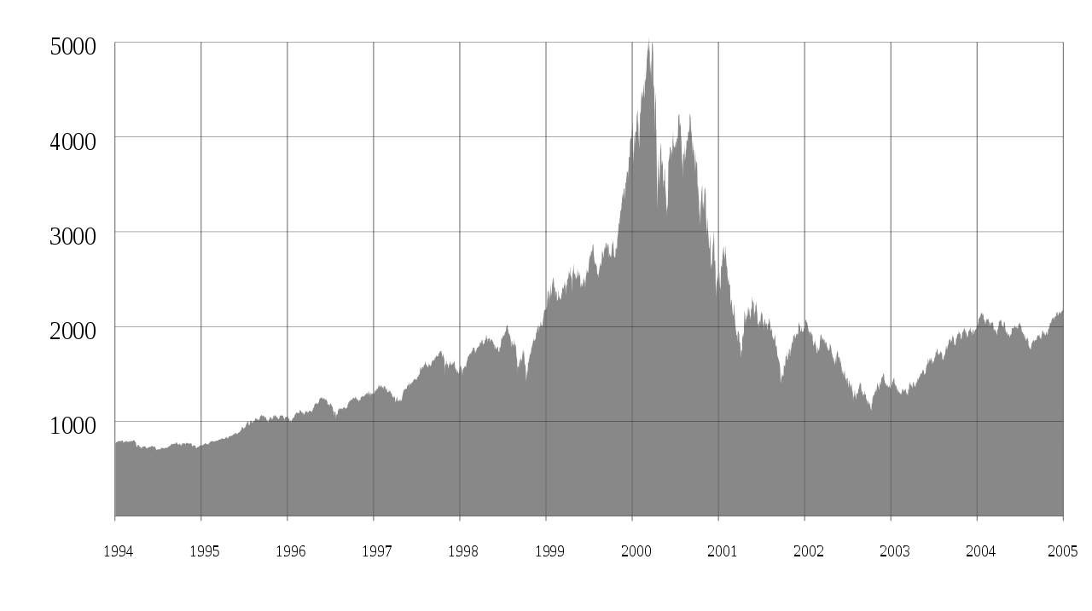
The So-called “Dot-Com” Bubble and Burst (1995-2000)
Public domain image taken from Wikipedia at https://en.wikipedia.org/wiki/File:Nasdaq_Composite_dot-com_bubble.svg

Slide 6
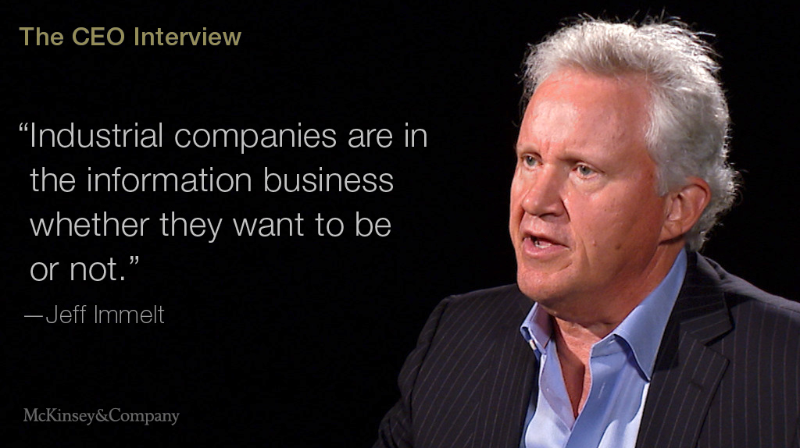
GE is a Software Company

Slide 7
Short History of the Software Industry
1959
  First mentioning of term “software”
1969
  US DoJ separates hard- from software
1980ties
  From vertical to horizontal integration
  Growth of platforms and ecosystems
1990ties
  Centralization, dominance of Windows
2000ties
  Diversification, multiple platforms
  Growth of open source software
2010ties
  Back to vertical, cloud computing

Slide 8
Main Industry Players
Software vendors
  Produce products
    A.k.a. “standard software” or “commercial off-the-shelf software” (COTS)
Operating services firms
  Operate any form of software (and hardware)
Development services firms
  Produce custom software
Implementation services firms
  Adjust software products for use by customers
Regulatory bodies

Slide 9
Customers Buy a “Solution”
Services
Application
Operating System
Hardware

Slide 10
Vertical Integration (Until 1980ties)
IBM
DEC
Services
Services
Application
Application
Operating System
Operating System
Hardware
Hardware

Slide 11
Horizontal Integration (Since 1990ties)
Services
IBM
Accenture
Tata
Application
Microsoft Word
GIMP
Twitter
Operating
System
Windows
Linux
OS X
Hardware
IBM
Dell
Samsung

Slide 12
Categories of Software Products
Applications
  Software that is not built upon
  Top-layer of the solution stack
Platforms
  Software that is built upon
  Everything that is not the top layer
Why does everyone want to be a platform?

Slide 13
Software Platform 1 / 2
application
application
...
application
platform, for example, operating system

Slide 14
Software Platform 2 / 2
Software platform
  Is an environment for the development and deployment of applications
    Implies split between applications on top of the platform
  Is a full set of application-independent life-cycle functions for applications
    Among many components, the largest collection (i.e. not just a library)
Customer (user) value of software platforms
  By definition, a platform in itself is useless
  Customer value is only created by applications

Slide 15
Software Platforms as a Product
Platforms are valuable
  Platforms are needed by the applications running on top of it
  Platforms can simplify IT department operations costs
An application license sale implies a platform sale

Slide 16
Pricing Power 1 / 2
Application
Money spent on solution
Platform

Slide 17
Pricing Power 2 / 2 [1]
Commercial
application
In-house
application
...
IBM Websphere
Money spent on solution
Oracle RDBMS
Microsoft Windows
[1] Not drawn to scale

Slide 18
Software Ecosystem
Software ecosystem
  The totality of actors (businesses and individuals),
  software applications and components,
  their relationships and goals
  for a software platform

Slide 19
The Software Ecosystem Wars
Total solution market
Total solution market
Ecosystem 1
Ecosystem 2
E 1
Ecosystem 2
Application
$$$$$
Application
$$$$$
A
$$$
Application
$$$$$
Total market size
Platform
Platform
Platform
$$$
$$$
P
$
$$$$$
Two competing platforms
with equal ecosystem size
Dominant platform
with larger ecosystem size

Slide 20
Open Source in the Ecosystem Wars
Total solution market
Total solution market
Ecosystem 1
Ecosystem 2
E 1
Ecosystem 2
Device
$$$$
Device
$$$$$$
D
$$
Device
$$$$$$$$
Total market size
Microsoft
Windows
$$$$
MW
$$
Linux
$$
Linux
$$$
[1] Not drawn to scale
Embedded devices
Windows vs. Linux
Embedded devices
Windows vs. Linux

Slide 21
Business Model
A business model
  Is a summary description (model) of how a business’ elements and their relationships interact to help the business achieve its strategic goals
  Example elements are products, partners, people, positions, etc. and example relationships are the processes that govern their interaction
Cf. marketing requirements document (MRD) a.k.a. business plan

Slide 22
Key
Activities
Customer Relationships
Key Partners
Customer Segments
Value
Proposition
Key Re-sources
Channels
Cost Structure
Revenue Streams

Slide 23
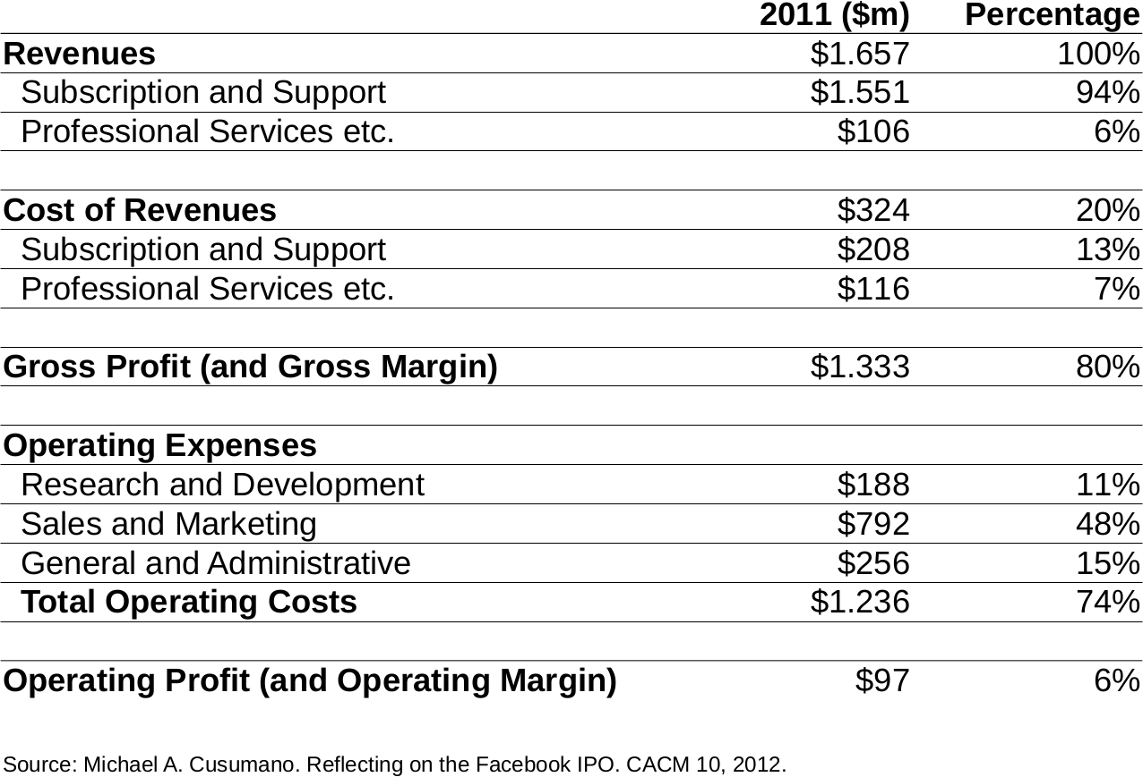

Slide 24
Review / Summary of Session
The software industry
Software platforms
Software ecosystems
Business models

Slide 25
Thank you! Questions?
dirk.riehle@fau.de – http://osr.cs.fau.de
dirk@riehle.org – http://dirkriehle.com – @dirkriehle
DR

Slide 26
Credits and License
Original version
  © 2012-2019 Dirk Riehle, some rights reserved
  Licensed under Creative Commons Attribution 4.0 International License
Contributions
  ...

